Slide 1
Introduction : Devops

Slide 2

About me
Sandeep Rawat (Devops Architect and Evangelist)
I am devops enthusiast.
I have led devops transformations in companies like snapdeal.com, mettl.com, beachbody.com.
Currently I’m working both as a trainer and DevOps Consultant.

Slide 3

Introduce Yourself
About you
Your technical abilities in Devops
What's your expectation from the program

Slide 4

Learning by Implementing
We will learn by implementing various phases of DevOps:
To simulate the learning conditions we will use a web app which will have 3 parts
A web server acting as a proxy for all the requests
Dynamic content served by an application server
MySQL as database

Slide 5
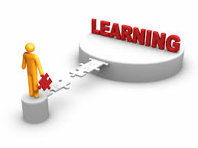
Agenda
Schedule Day 1:
Introduction
Training methodology
Introduction to Devops
Concepts behind
Version Control System, Concepts behind
Version Control demo using git
Cloud Introduction, AWS Components
Cloud demo using AWS
CI Description, Jenkins, Hands on
CD concepts, phases, Hands on

Slide 6

Schedule Day 2:
Recap
SCM, Concepts behind
SCM demo via Puppet
Monitoring, Concept behind
Monitoring demo via Zabbix, ELK, NewRelic
Docker introduction, containerization, containers, images
Basic docker demo

Slide 7
Hands On
https://github.com/OpsTree/HandbooksTraining
https://s3-us-west-2.amazonaws.com/target-training/Day1PPT.zip
https://s3-us-west-2.amazonaws.com/target-training/Day2PPT.zip
https://s3-us-west-2.amazonaws.com/target-training/Handbooks.zip

Slide 8
